Slide 1

ABDULLAHI DANJUMA KASSIM

Slide 2
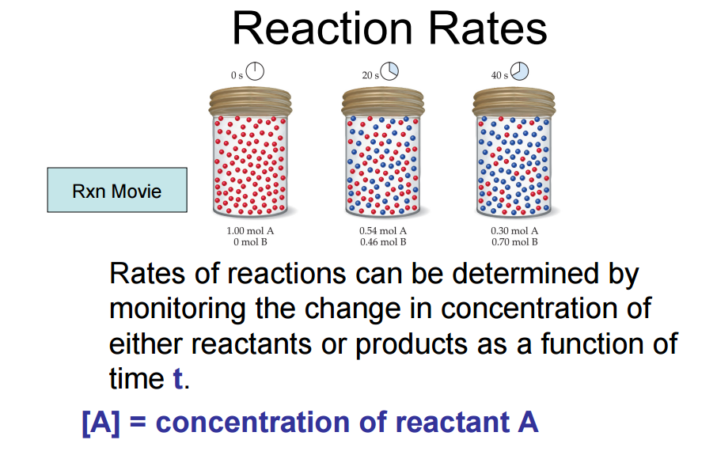

Slide 3

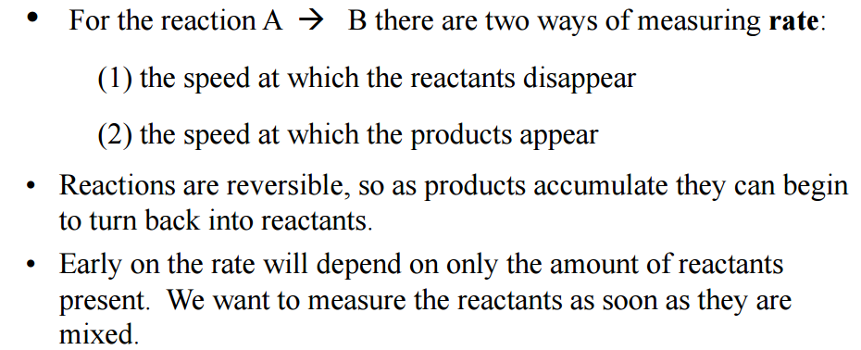



Slide 4
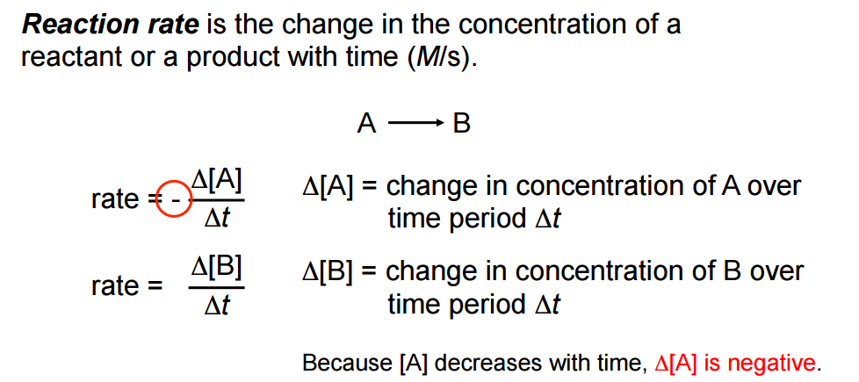

Slide 5

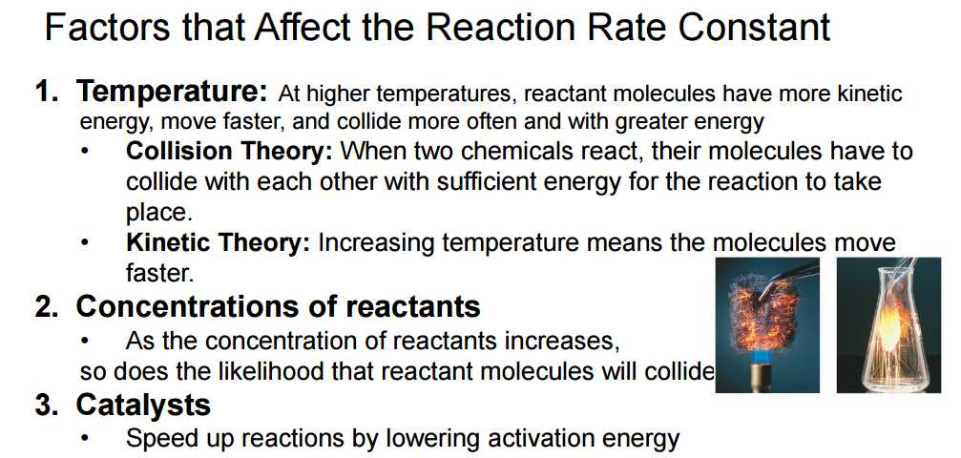

Slide 6


Slide 7
How do catalysts work?
A catalyst increases reaction rates in a slightly different way from other methods of increasing reaction rate. The function of a catalyst is to lower the activation energy so that a greater proportion of the particles have enough energy to react. A catalyst can lower the activation energy for a reaction by:
orienting the reacting particles in such a way that successful collisions are more likely
reacting with the reactants to form an intermediate that requires lower energy to form the product
Some metals e.g. platinum, copper and iron can act as catalysts in certain reactions. In our own bodies, we have enzymes that are catalysts, which help to speed up biological reactions. Catalysts generally react with one or more of the reactants to form a chemical intermediate, which then reacts to form the final product. The chemical intermediate is sometimes called the activated complex.

Slide 8
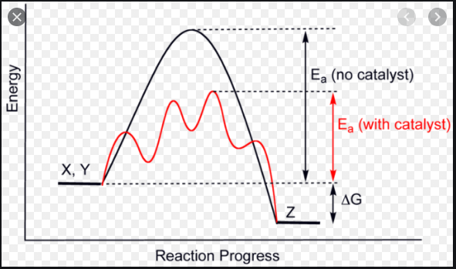

Slide 9
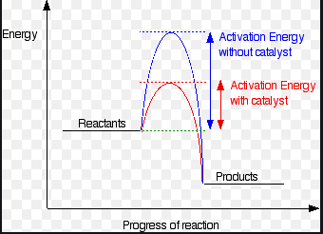
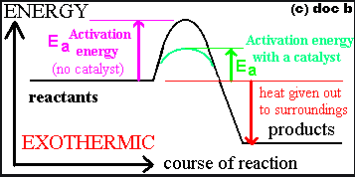

Slide 10
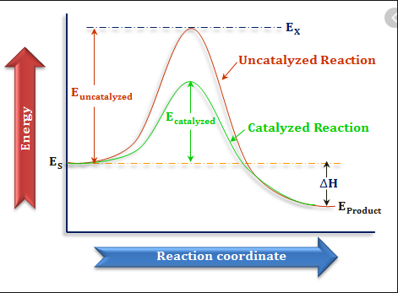
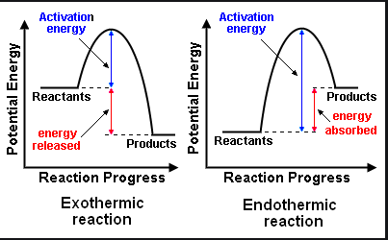

Slide 11
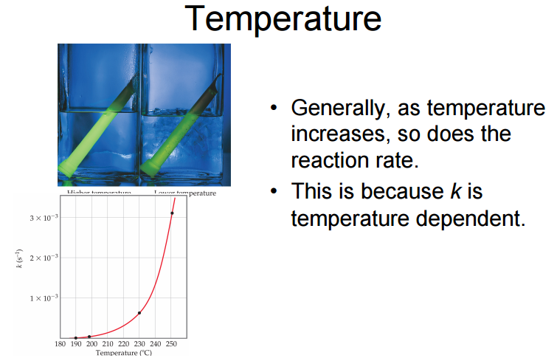

Slide 12
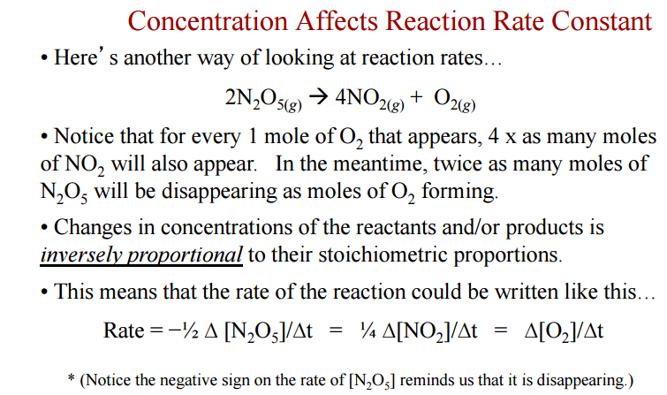


Slide 13

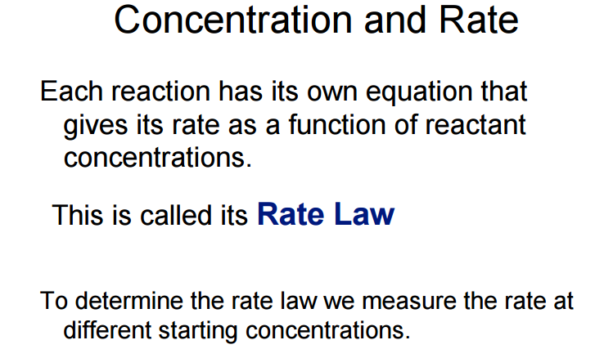

Slide 14
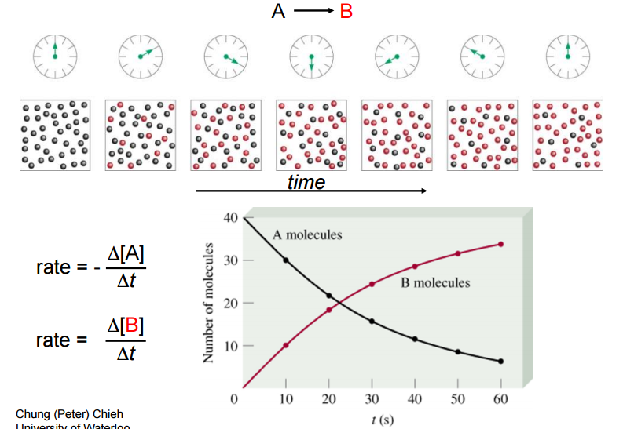

Slide 15
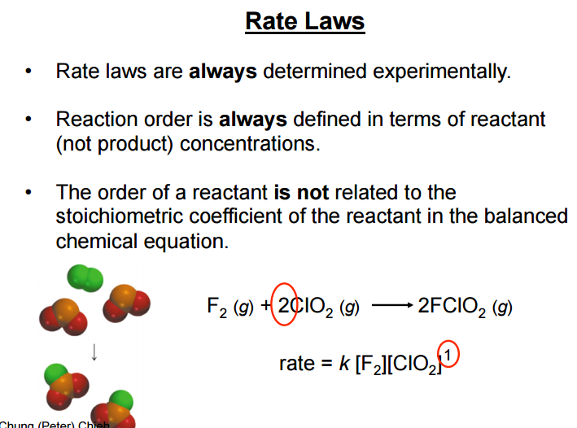

Slide 16
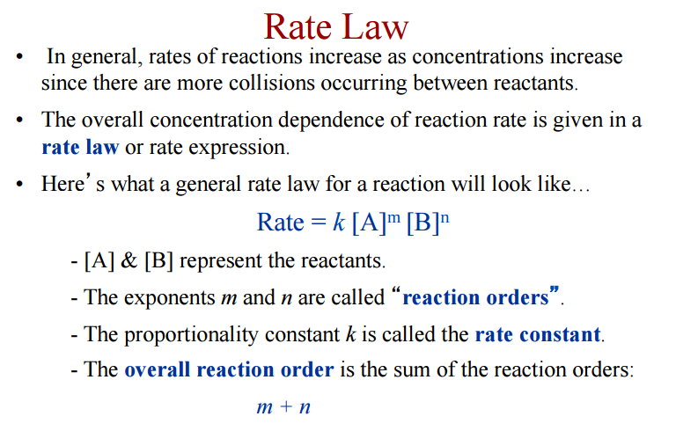

Slide 17
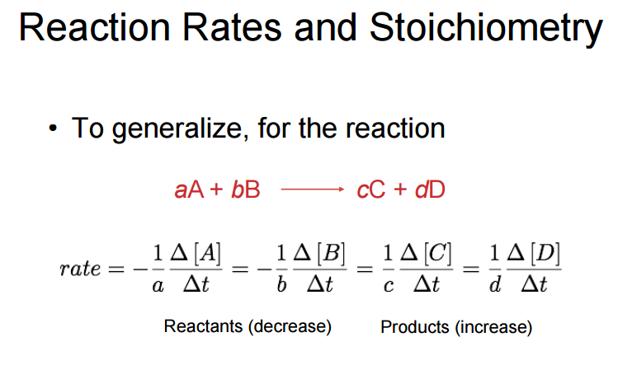

Slide 18
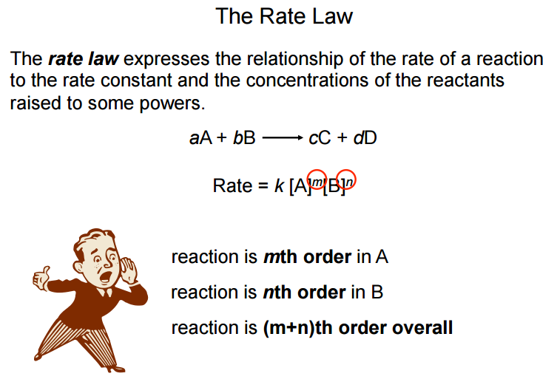
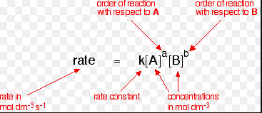

Slide 19
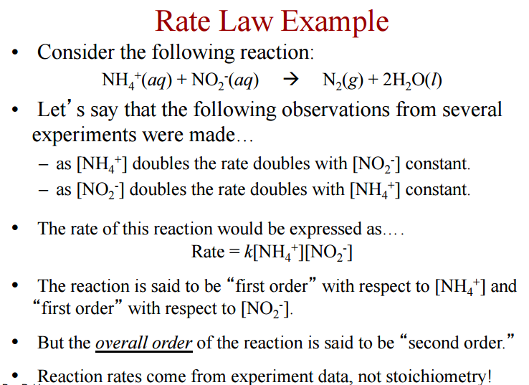

Slide 20

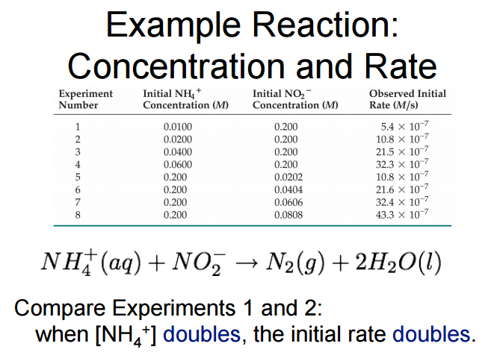

Slide 21
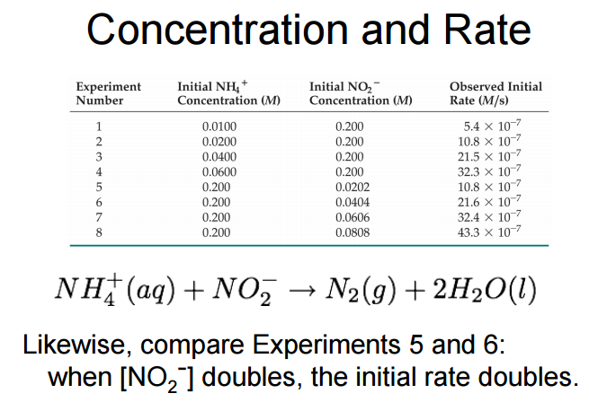

Slide 22
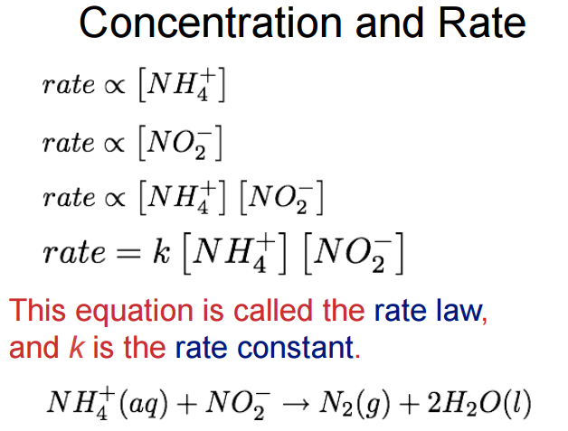

Slide 23
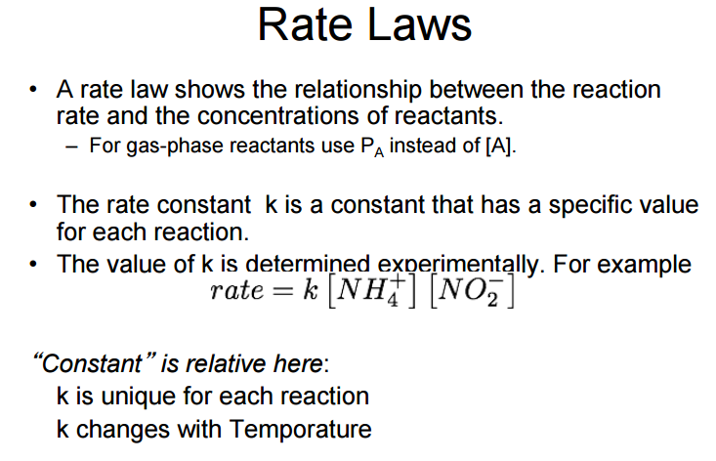

Slide 24
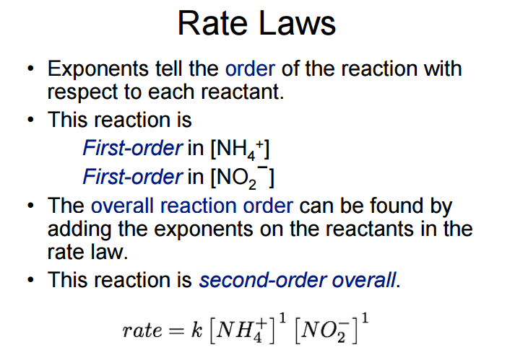

Slide 25
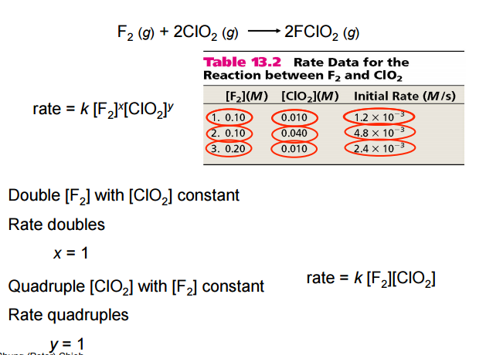

Slide 26
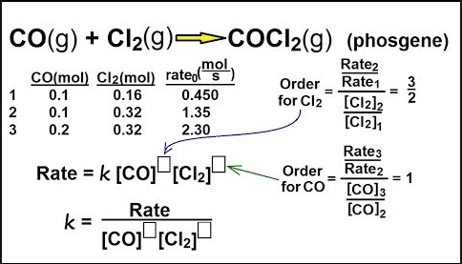

Slide 27
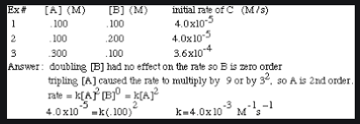

Slide 28
